Slide 1
UBA Technology Cost Optimization
Enhancing Financial Performance through Strategic Technology Spend Reduction

Slide 2
Executive Summary
UBA, as a market leader, faces rising operational costs, particularly within technology. This proposal outlines a structured cost optimization initiative focused on technology spend, designed to reduce the cost-to-income ratio and enhance long-term value.

Slide 3
Our Methodology
1. Mobilization: Define scope, gather data, setup governance.
2. Rapid Assessment: Identify major cost drivers and inefficiencies.
3. Opportunity Validation: Deep-dive analysis and stakeholder input.
4. Implementation Planning: Build roadmap and business case.

Slide 4
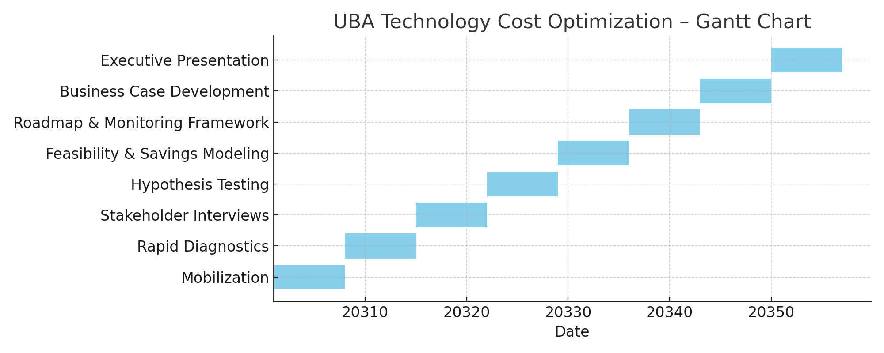
2-Month Implementation Gantt Chart
Overview of weekly project execution plan.

